Slide 1
Gaussian Elimination
By
Dr. Md. Rajibul Islam CSE, UAP
Notes:
‹#›

Slide 2
Naïve Gaussian Elimination
A method to solve simultaneous linear equations of the form [A][X]=[C]
Coefficient matrix
Right-hand side vector
Solution vector/ unknown vector
Two steps
1. Forward Elimination
2. Back Substitution
Notes:
‹#›

Slide 3
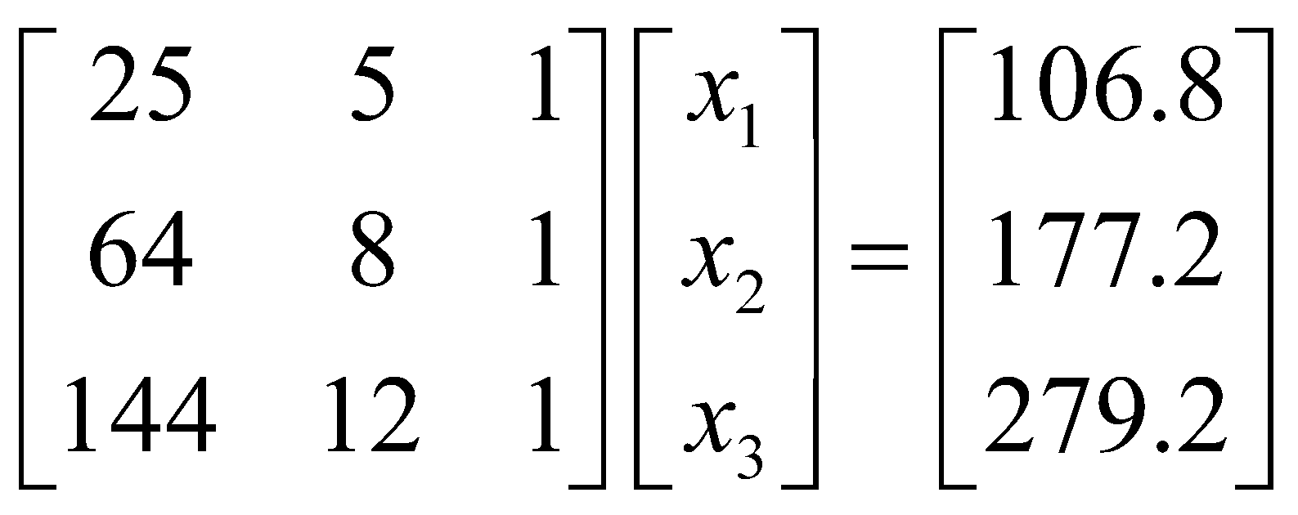
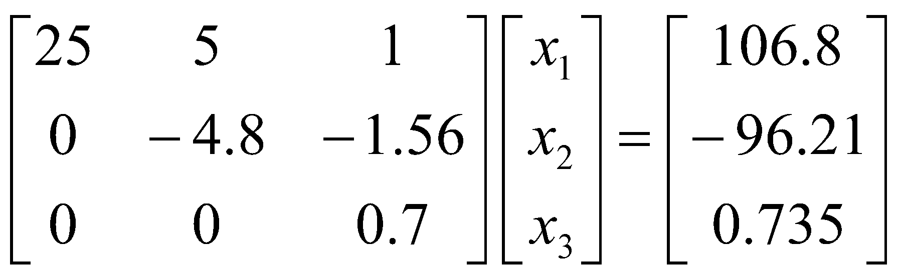
Forward Elimination
The goal of forward elimination is to transform the coefficient matrix into an upper triangular matrix
Notes:
‹#›

Slide 4
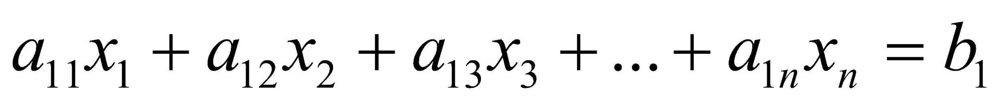
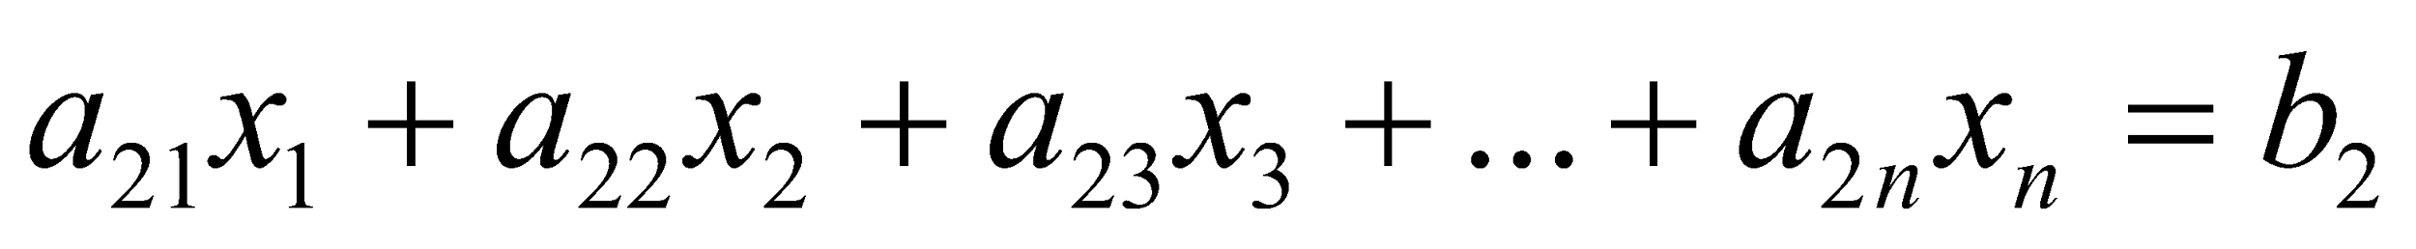
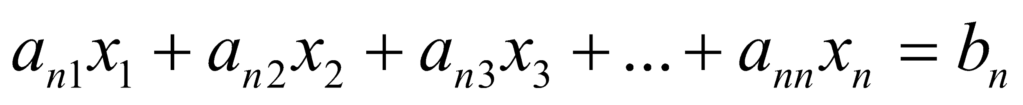
Forward Elimination
A set of n equations and n unknowns
. .
. .
. .
(n-1) steps of forward elimination
Notes:
‹#›

Slide 5
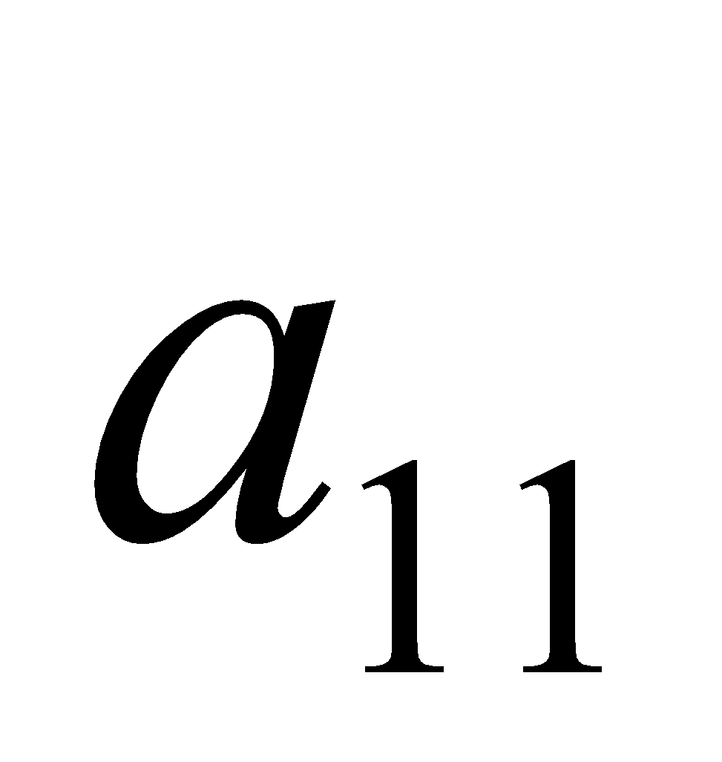
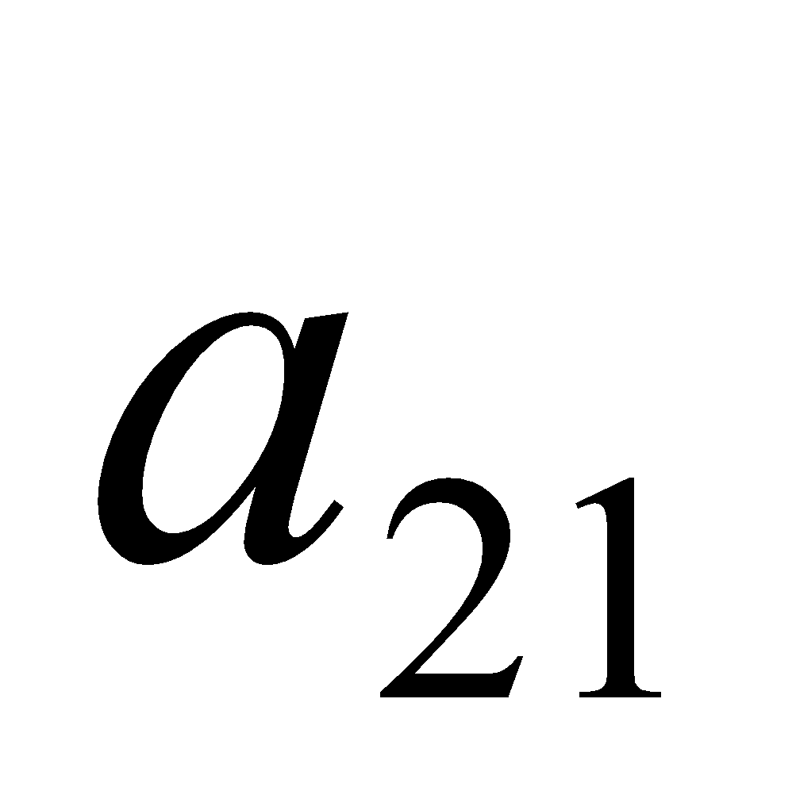
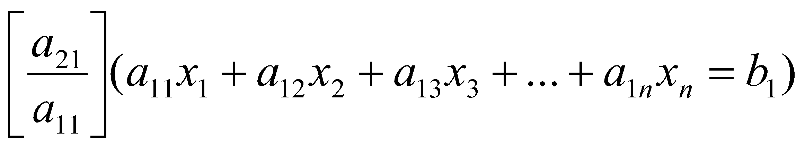
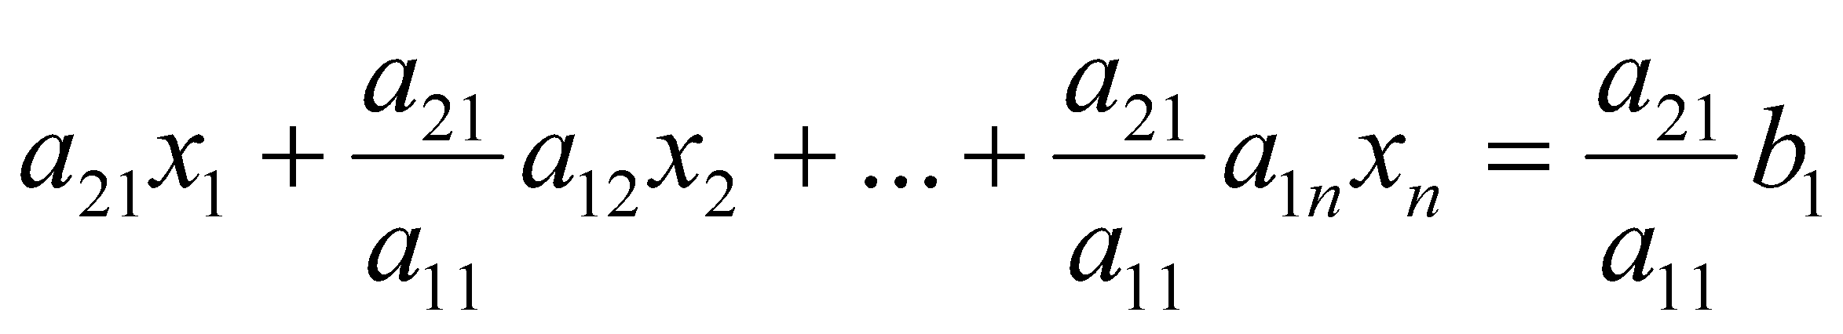
Forward Elimination
Step 1
For Equation 2, divide Equation 1 by and multiply by .
Notes:
‹#›

Slide 6
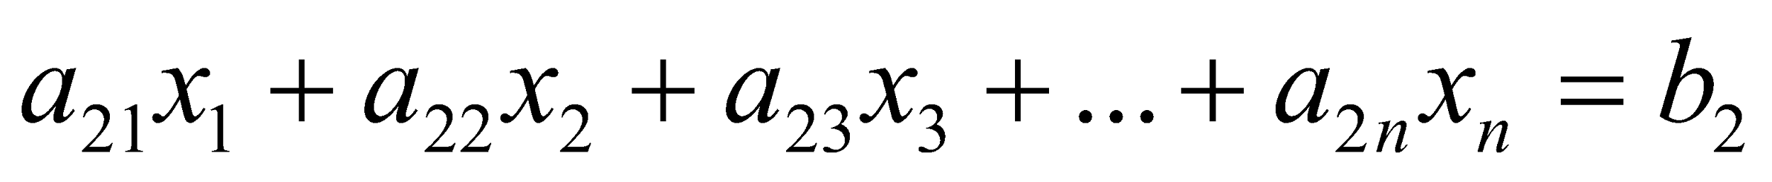
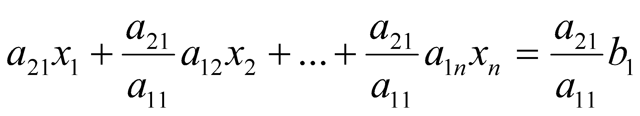
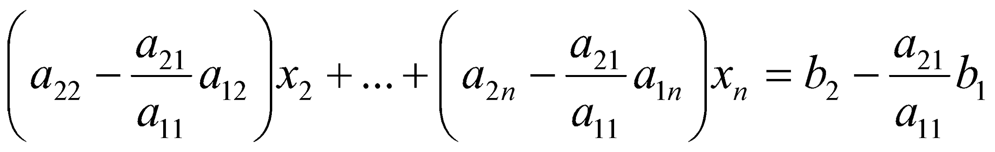
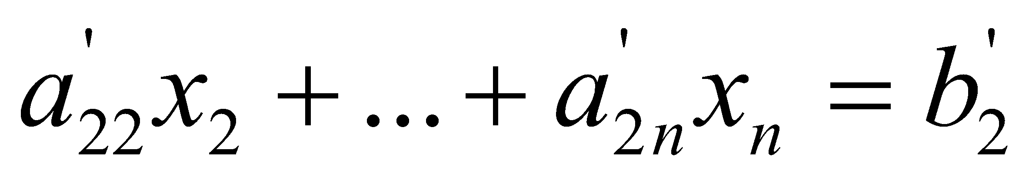
Forward Elimination
Subtract the result from Equation 2.
−
_________________________________________________
or
Notes:
‹#›

Slide 7
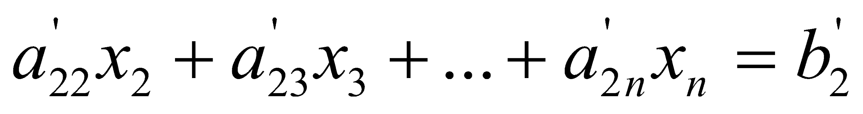
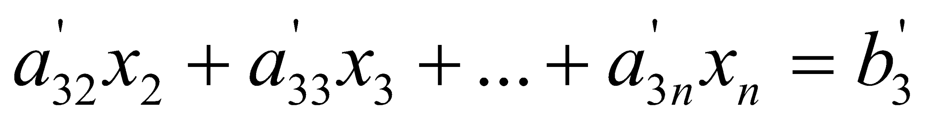
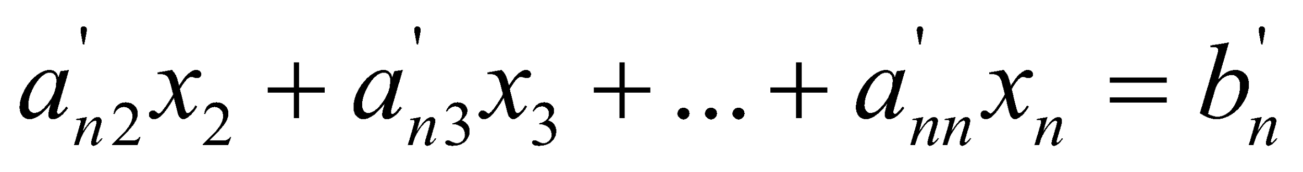
Forward Elimination
Repeat this procedure for the remaining equations to reduce the set of equations as
. . .
. . .
. . .
End of Step 1
Notes:
‹#›

Slide 8
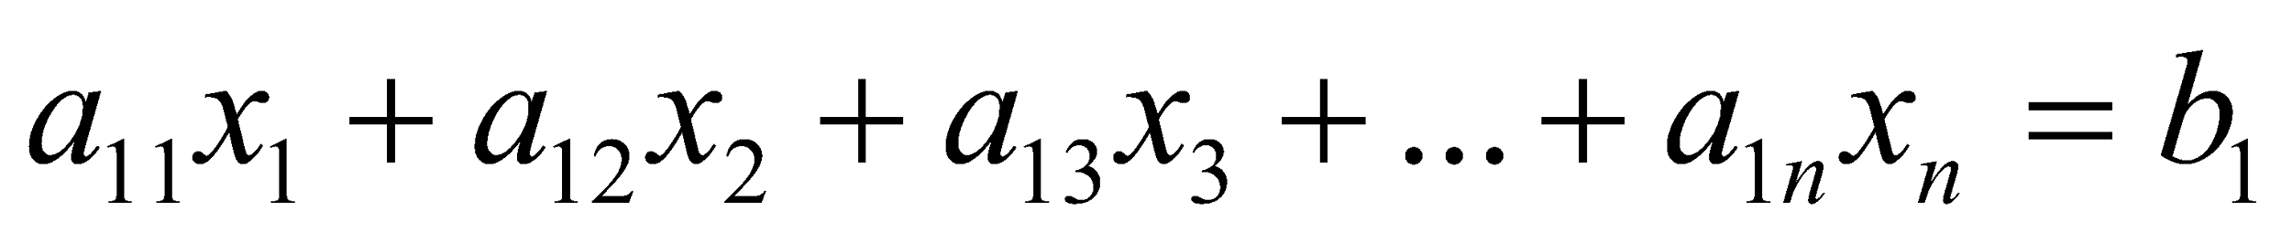
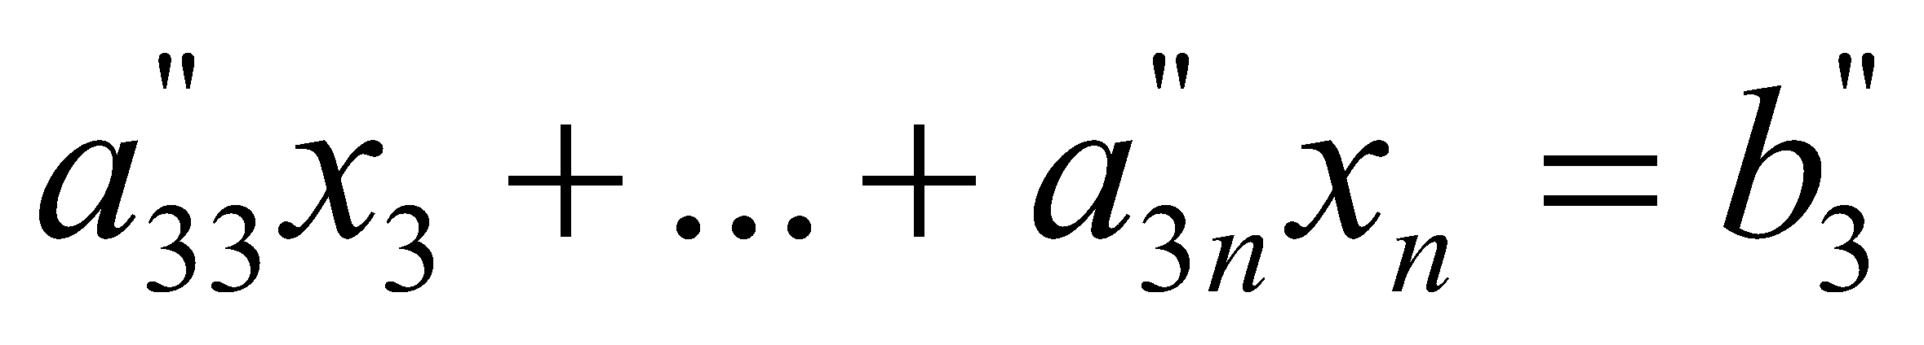
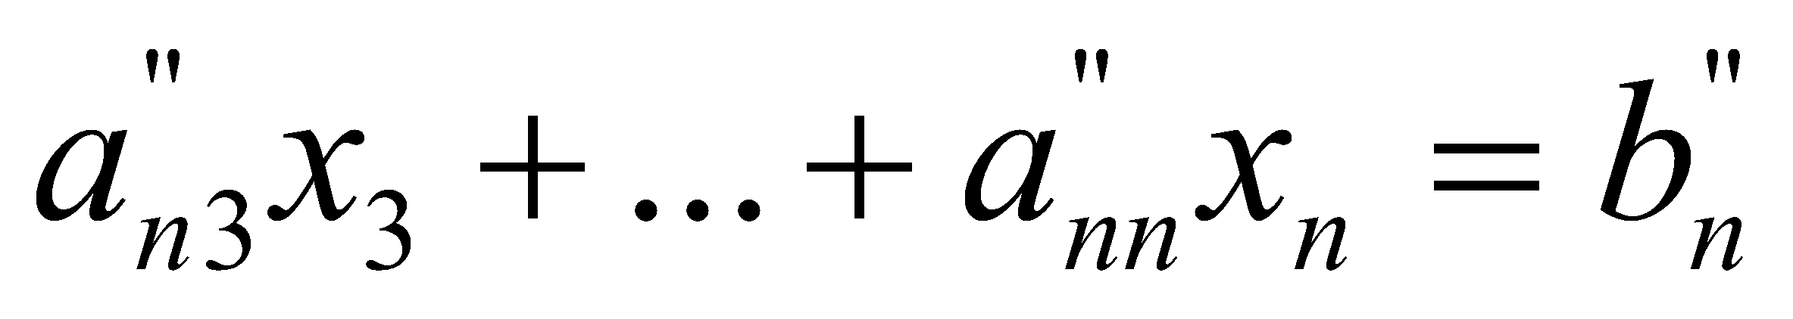
Forward Elimination
Step 2
Repeat the same procedure for the 3rd term of Equation 3.
. .
. .
. .
End of Step 2
Notes:
‹#›

Slide 9
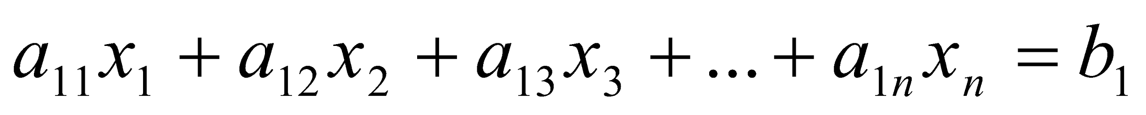
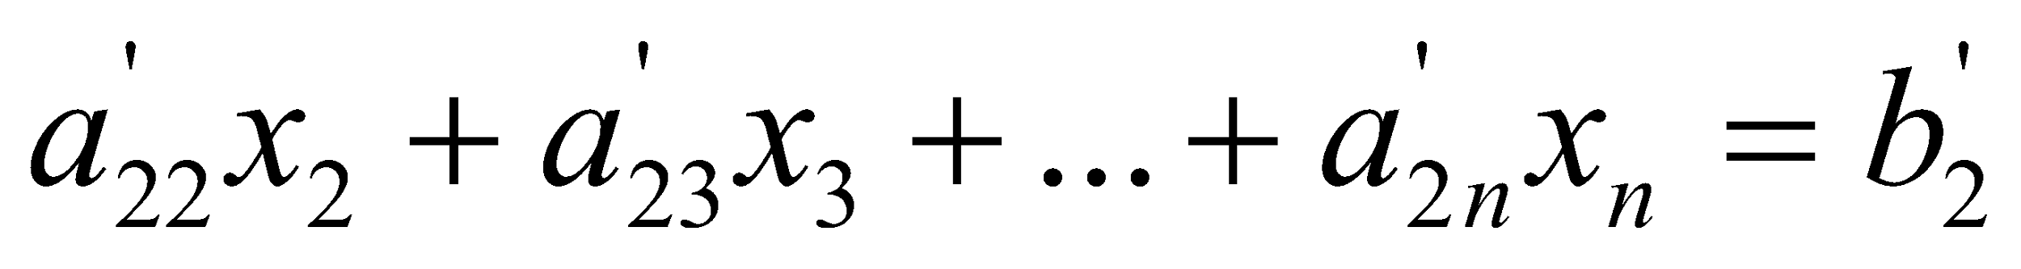
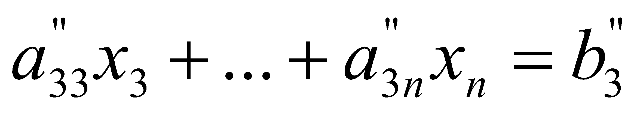
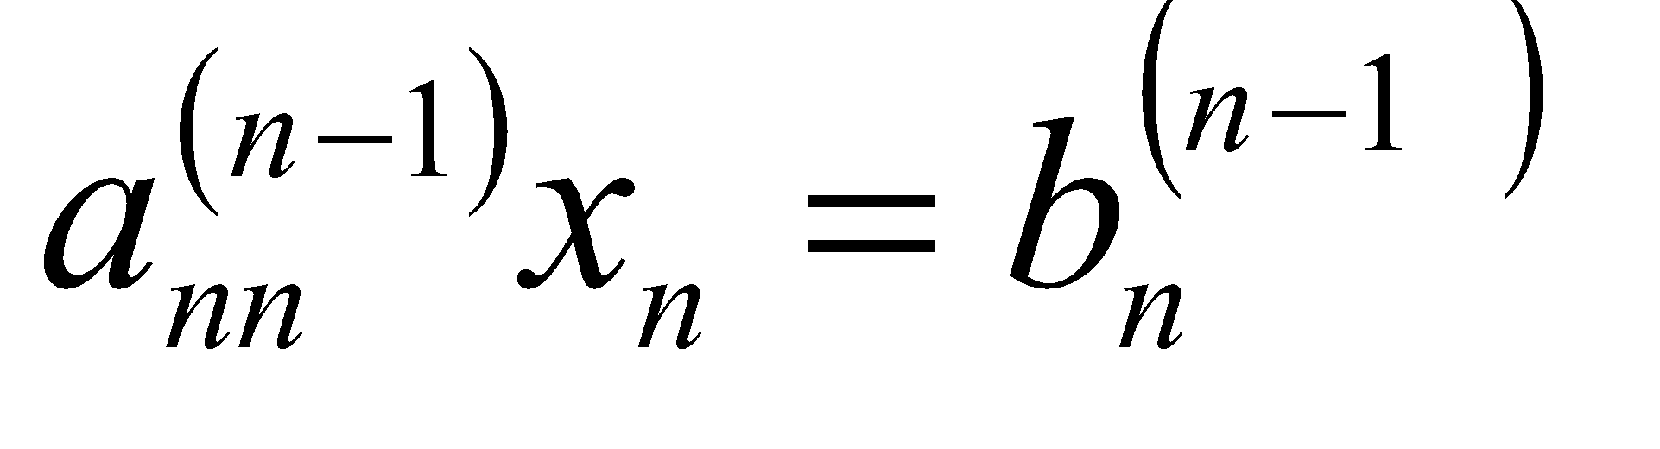
Forward Elimination
At the end of (n-1) Forward Elimination steps, the system of equations will look like
. .
. .
. .
End of Step (n-1)
Notes:
‹#›

Slide 10
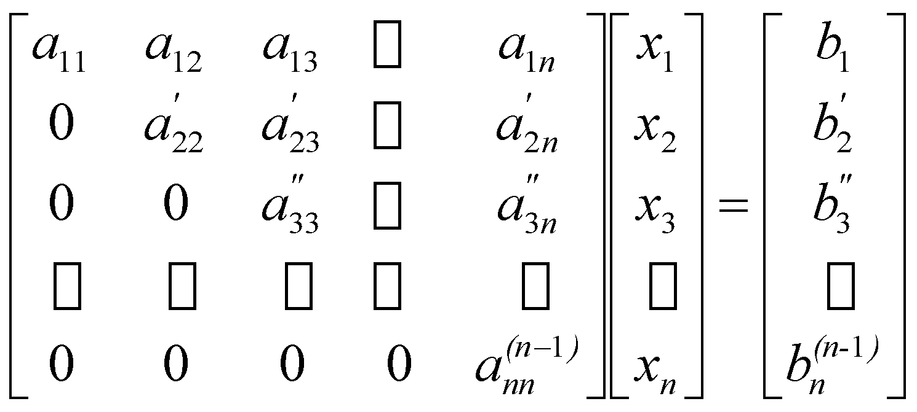
Matrix Form at End of Forward Elimination
Notes:
‹#›

Slide 11
Back Substitution
Solve each equation starting from the last equation
Example of a system of 3 equations
Notes:
‹#›

Slide 12
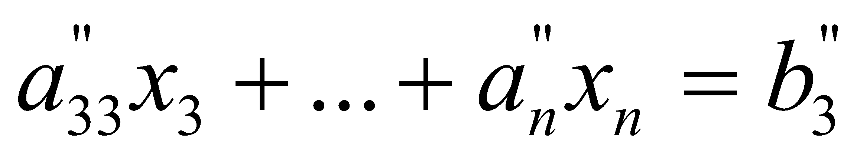
Back Substitution Starting Eqns
. .
. .
. .
Notes:
‹#›

Slide 13
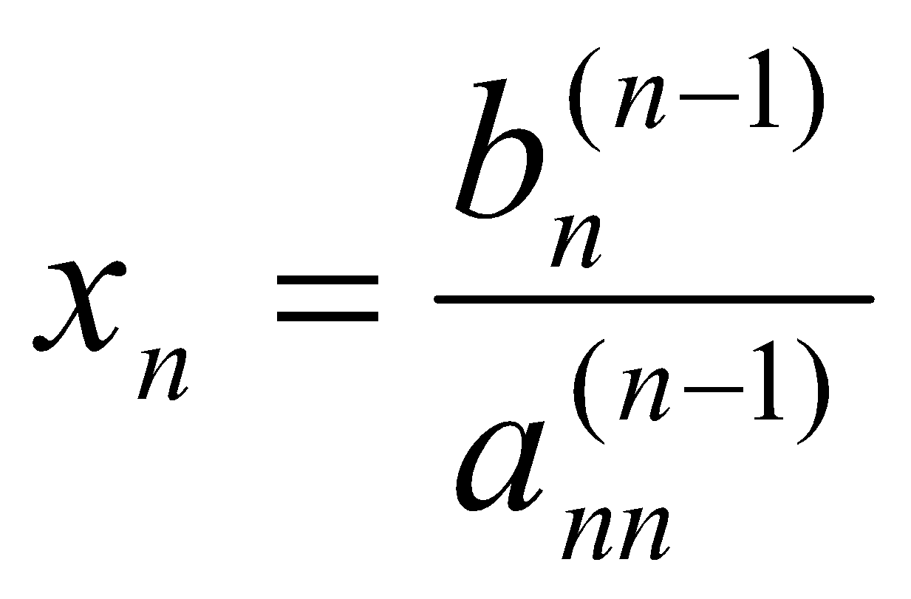
Back Substitution
Start with the last equation because it has only one unknown
Notes:
‹#›

Slide 14
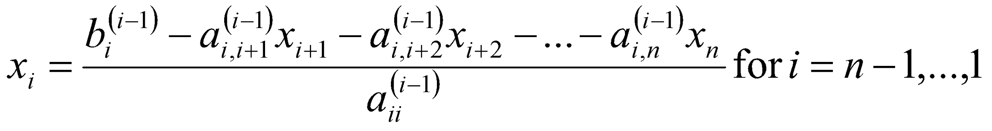
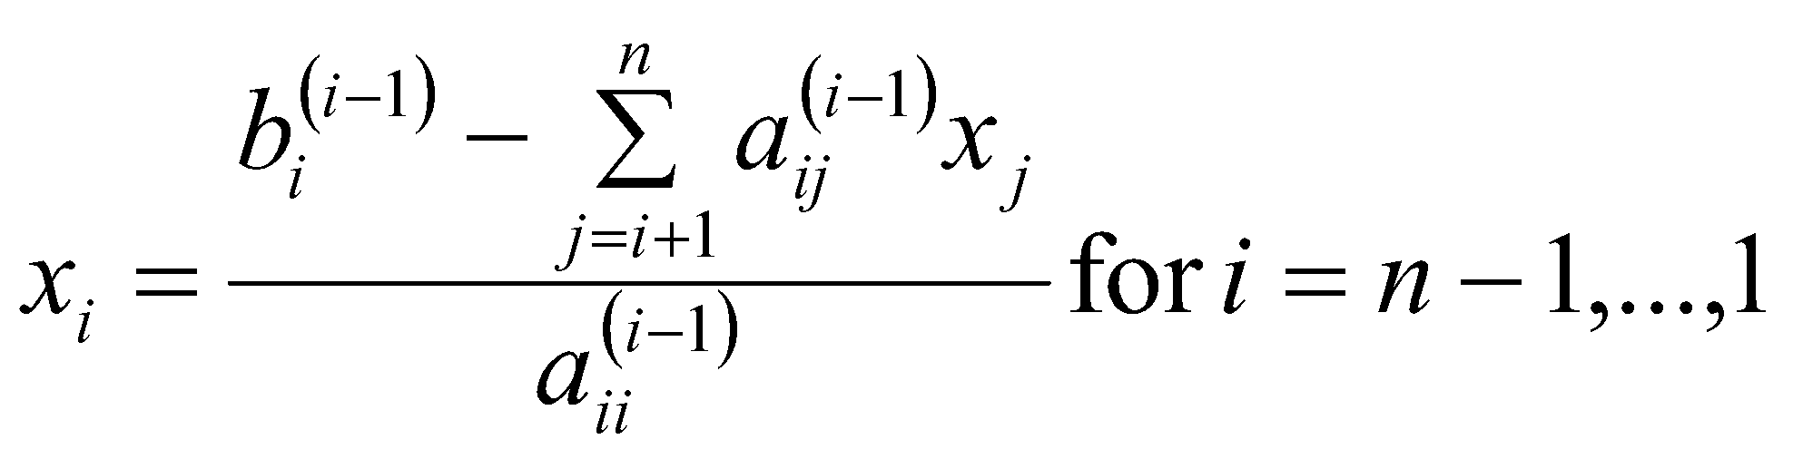
Back Substitution
corresponding values of x which will be involved in the negative elements
divided by the diagonal element corresponding to that unknown
Notes:
‹#›

Slide 15
THE END
Notes:
‹#›

Slide 16
Naïve Gauss Elimination Example
Notes:
‹#›

Slide 17

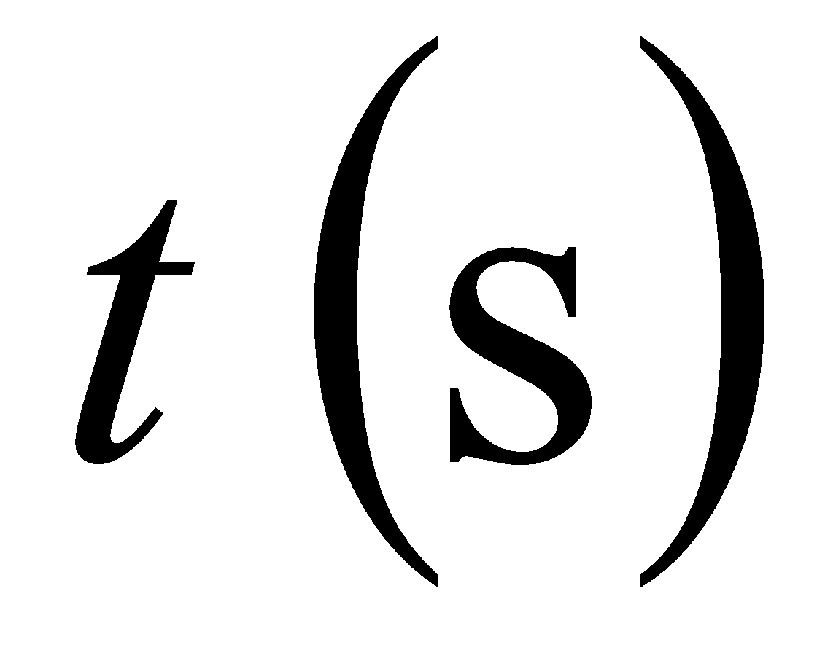
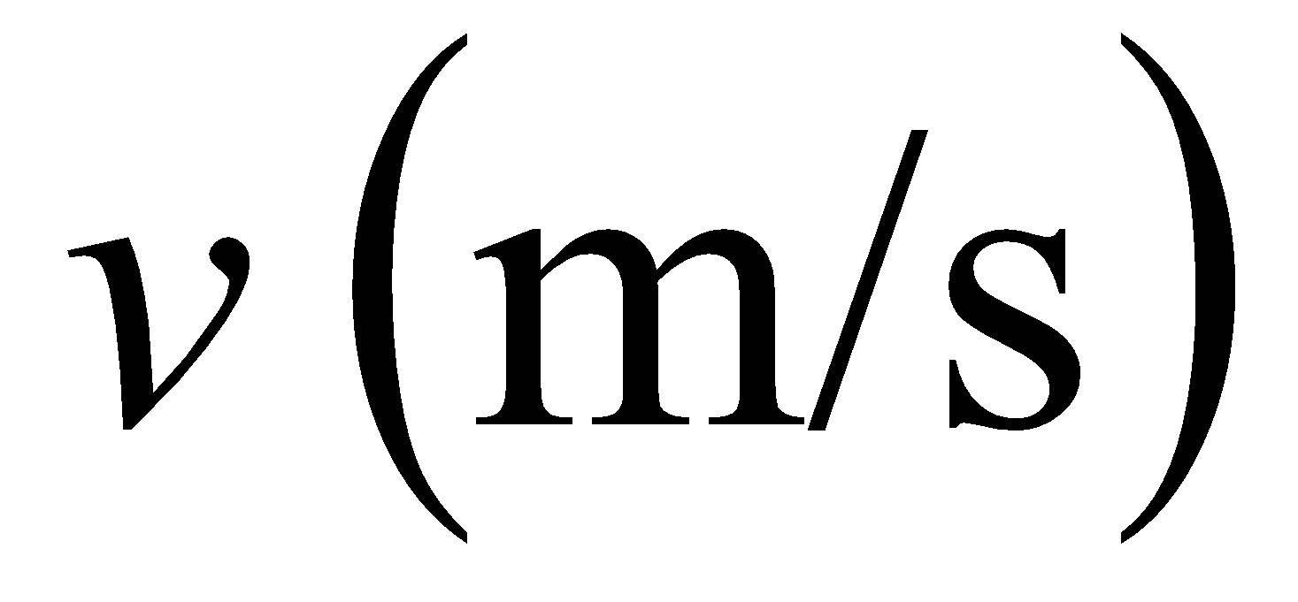
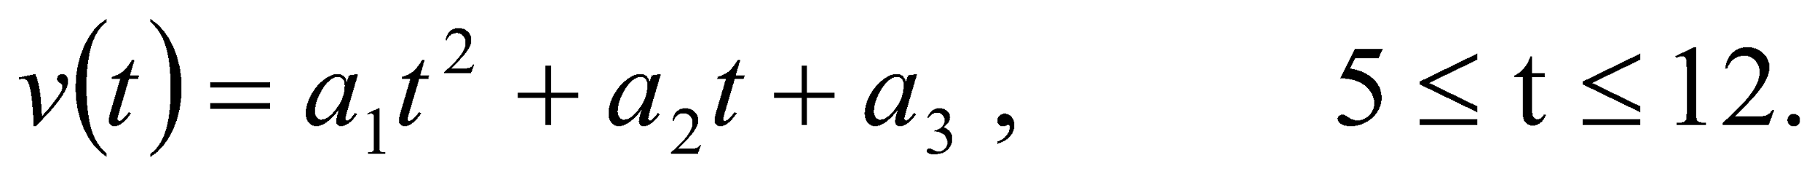
Example 1
The upward velocity of a rocket is given at three different times
Table 1 Velocity vs. time data.
Time, | Velocity,
5 | 106.8
8 | 177.2
12 | 279.2
The velocity data is approximated by a polynomial as:
Find the velocity at t=6 seconds .
Notes:
‹#›

Slide 18
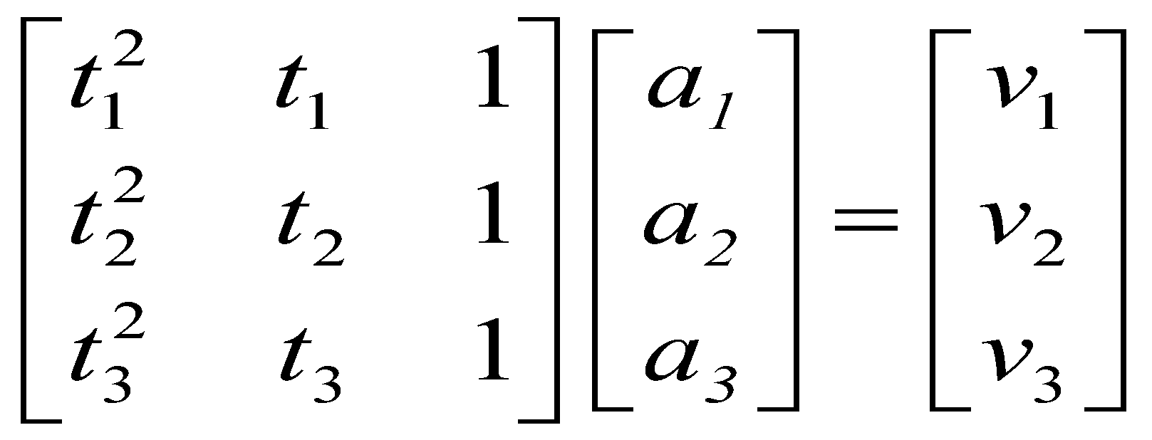
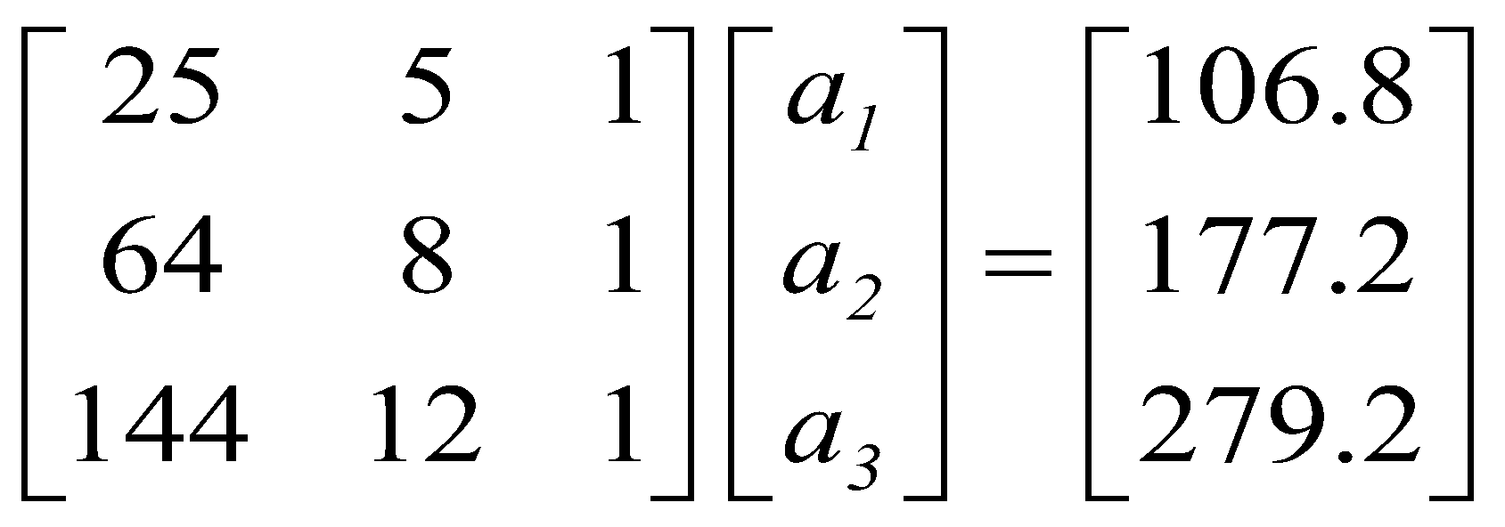
Example 1 Cont.
Assume
Results in a matrix template of the form:
Using data from Table 1, the matrix becomes:
Notes:
‹#›

Slide 19
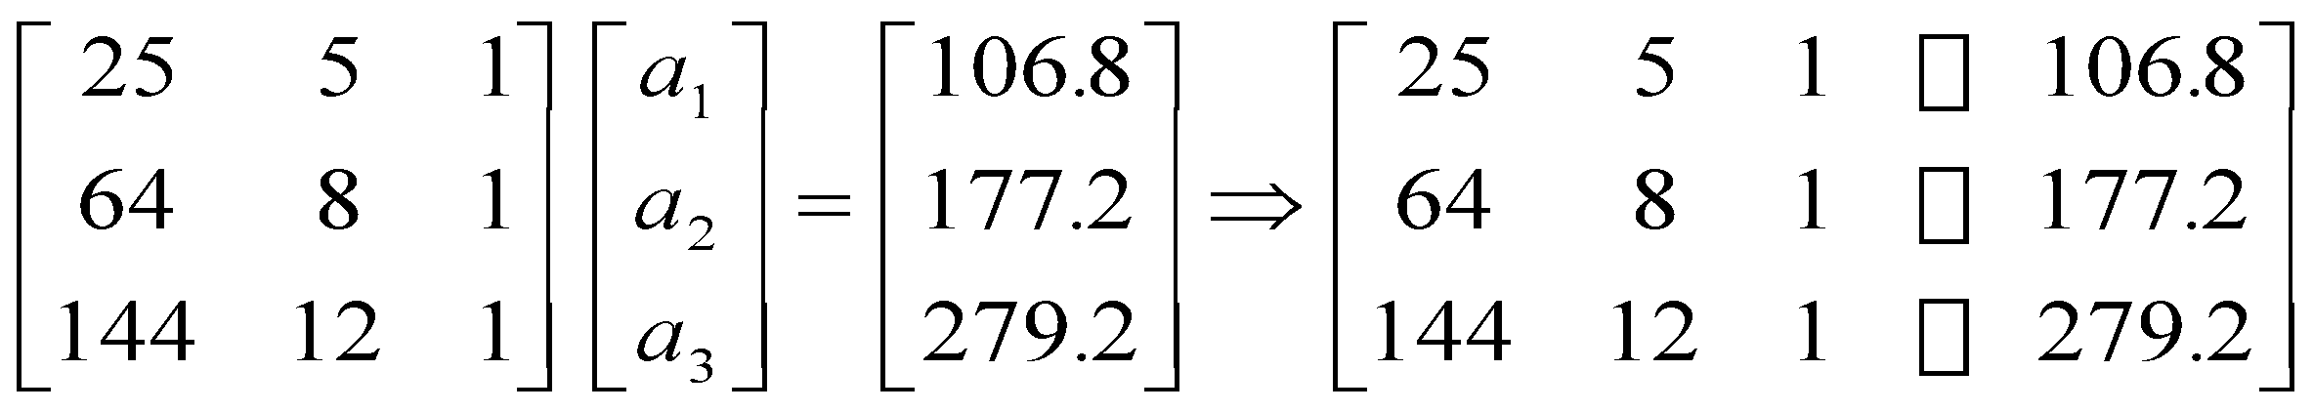
Example 1 Cont.
Forward Elimination
Back Substitution
Notes:
‹#›
‹#›

Slide 20
Forward Elimination
Notes:
‹#›
‹#›

Slide 21
Number of Steps of Forward Elimination
Number of steps of forward elimination is
(n−1)=(3−1)=2
Notes:
‹#›

Slide 22
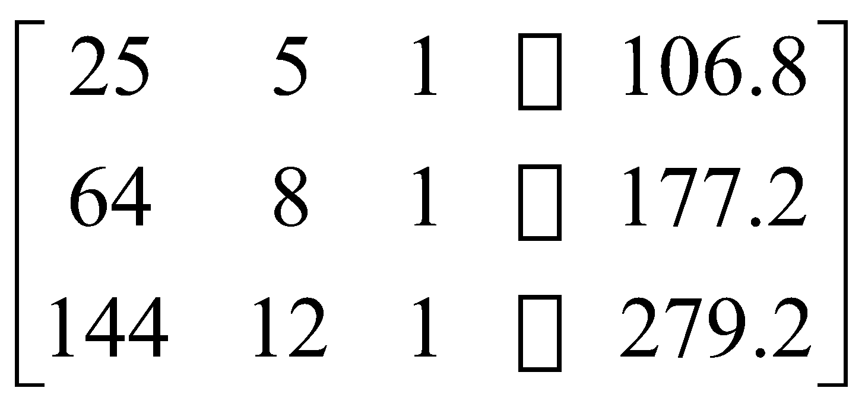
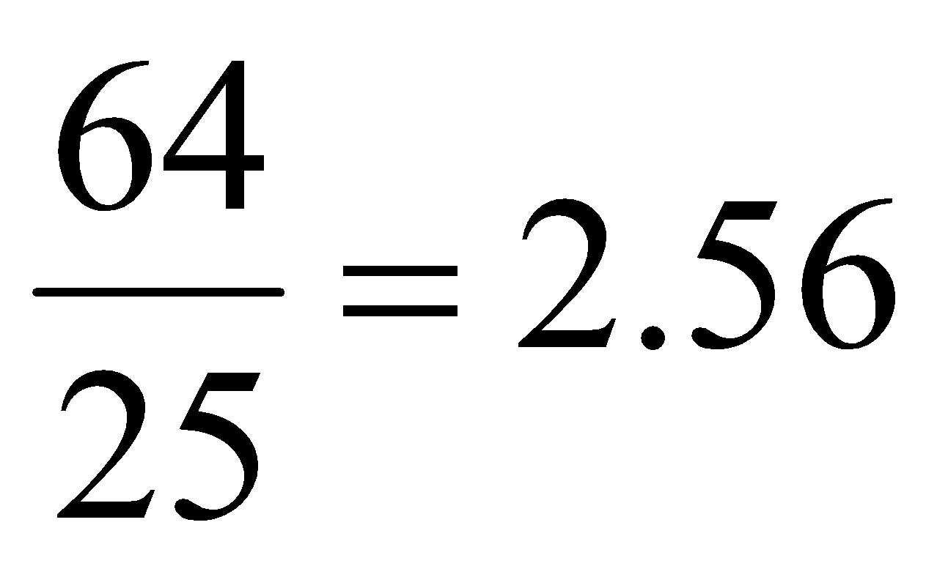
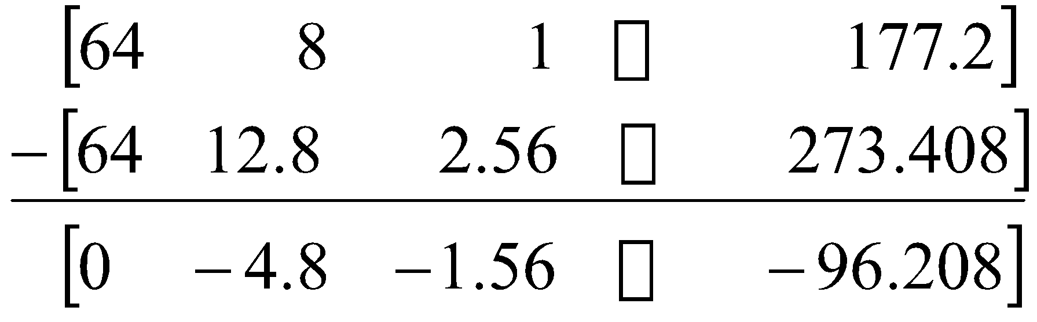
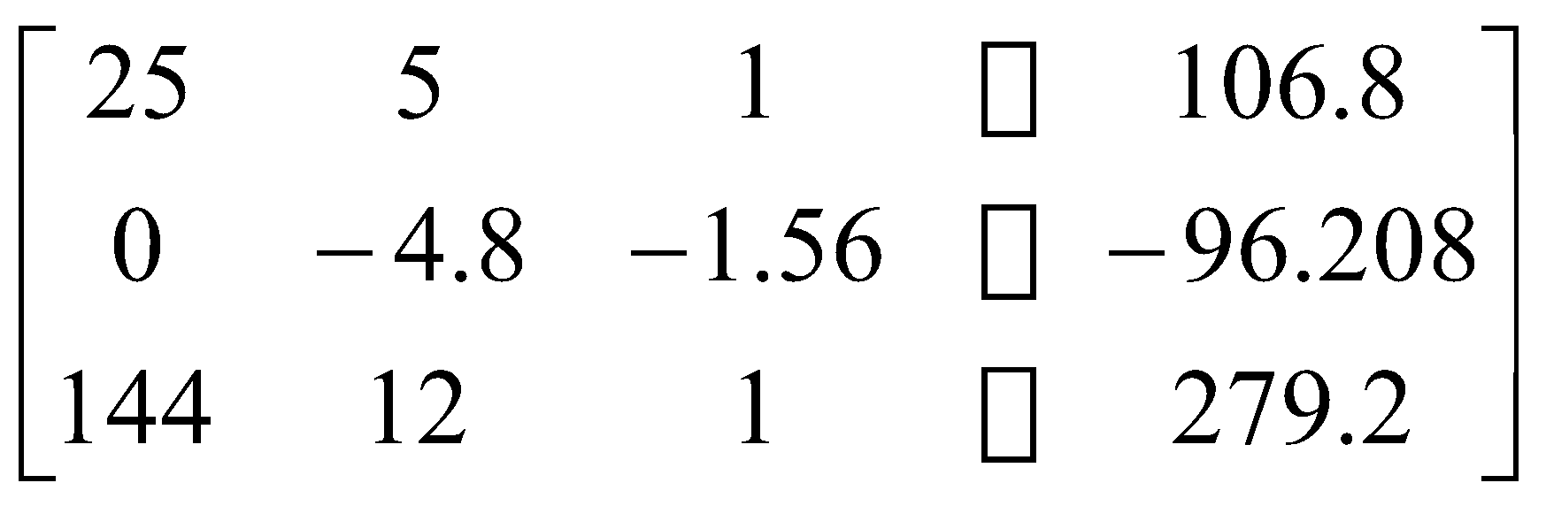
Forward Elimination: Step 1
Divide Equation 1 by 25 and
multiply it by 64, .
.
Subtract the result from Equation 2
Substitute new equation for Equation 2
Notes:
‹#›
‹#›

Slide 23
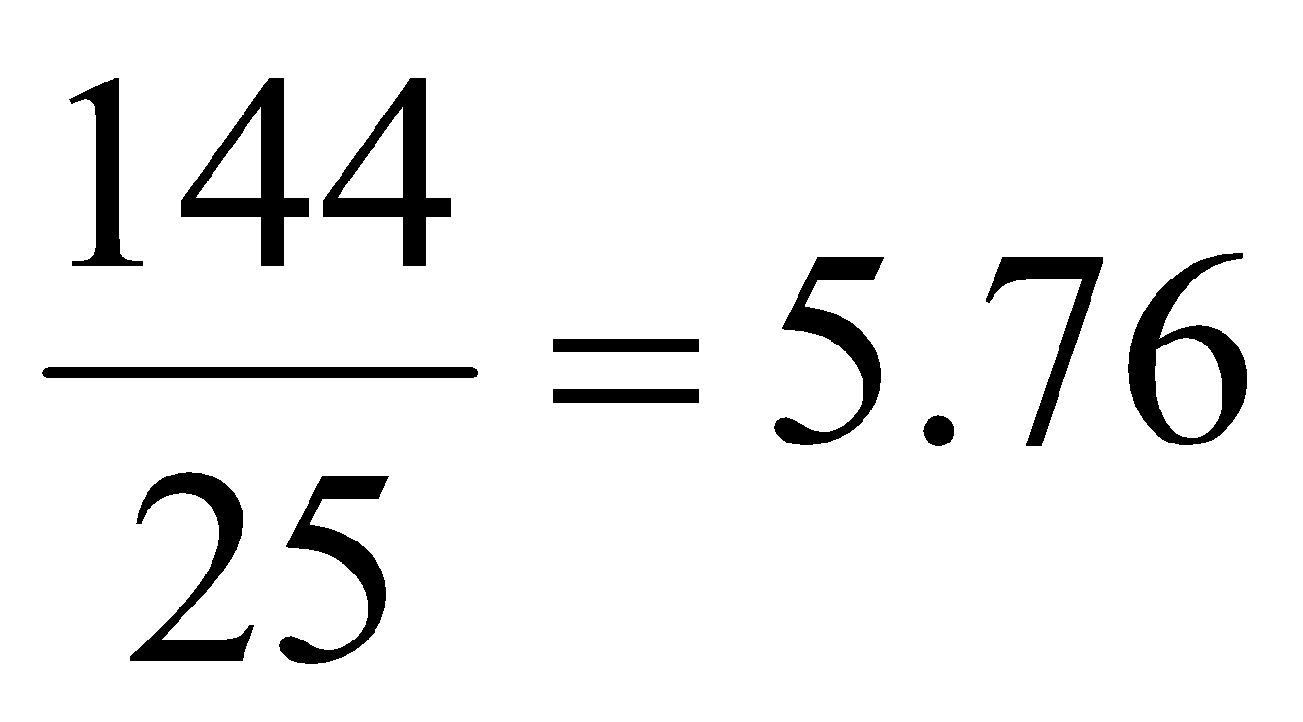
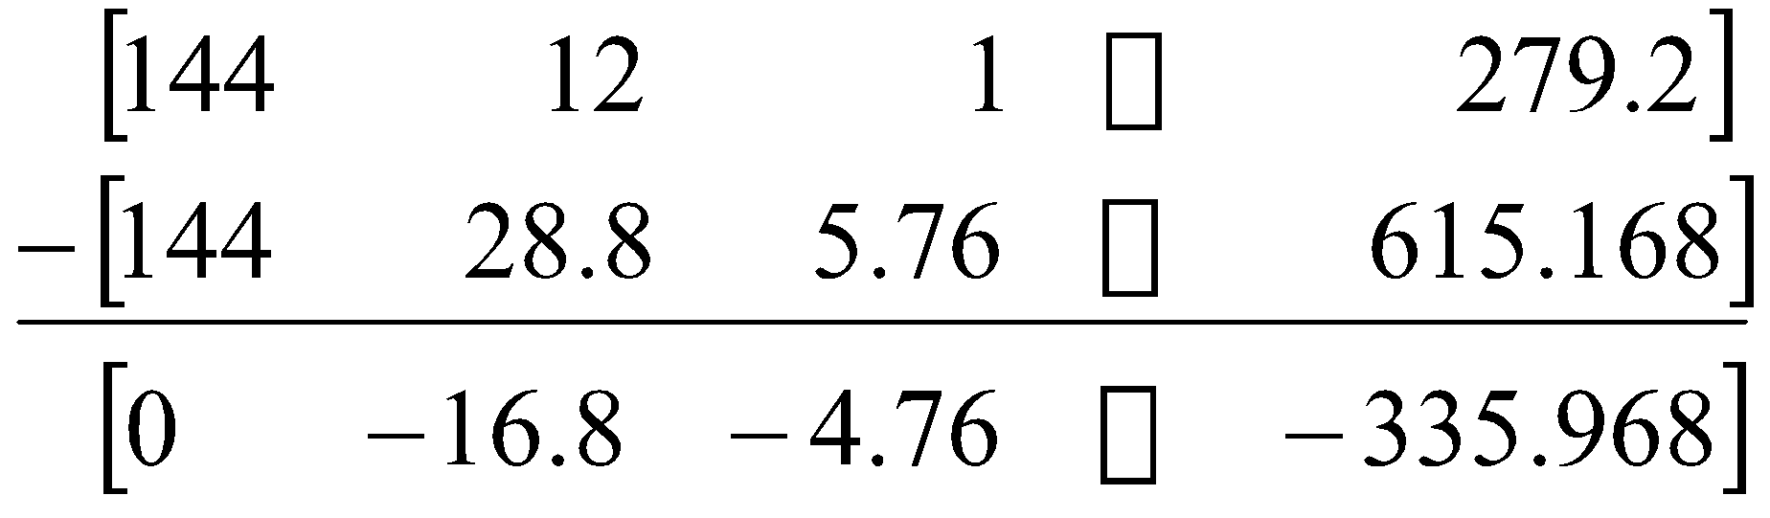
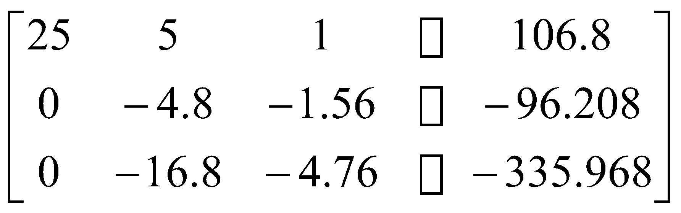
Forward Elimination: Step 1 (cont.)
Divide Equation 1 by 25 and
multiply it by 144, .
.
Subtract the result from Equation 3
Substitute new equation for Equation 3
Notes:
‹#›
‹#›

Slide 24
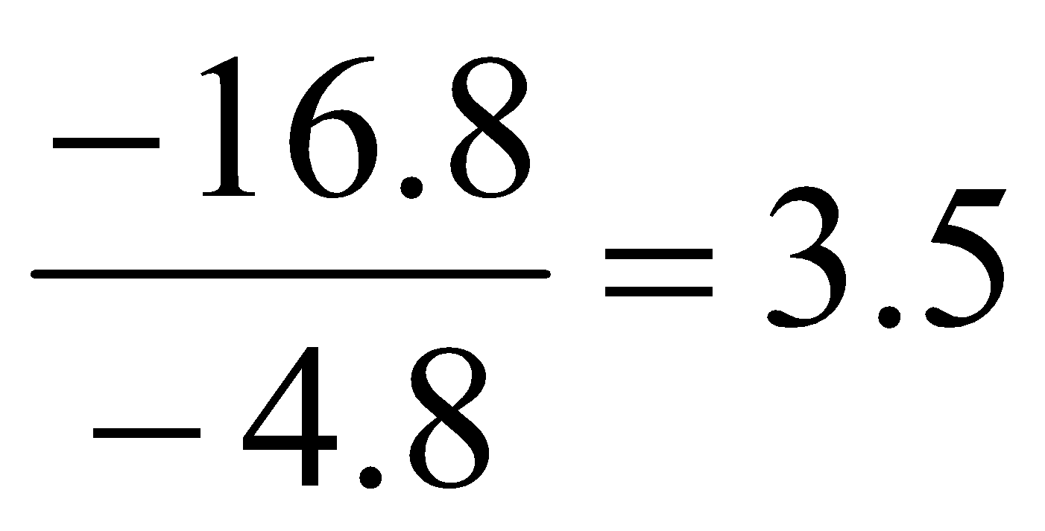
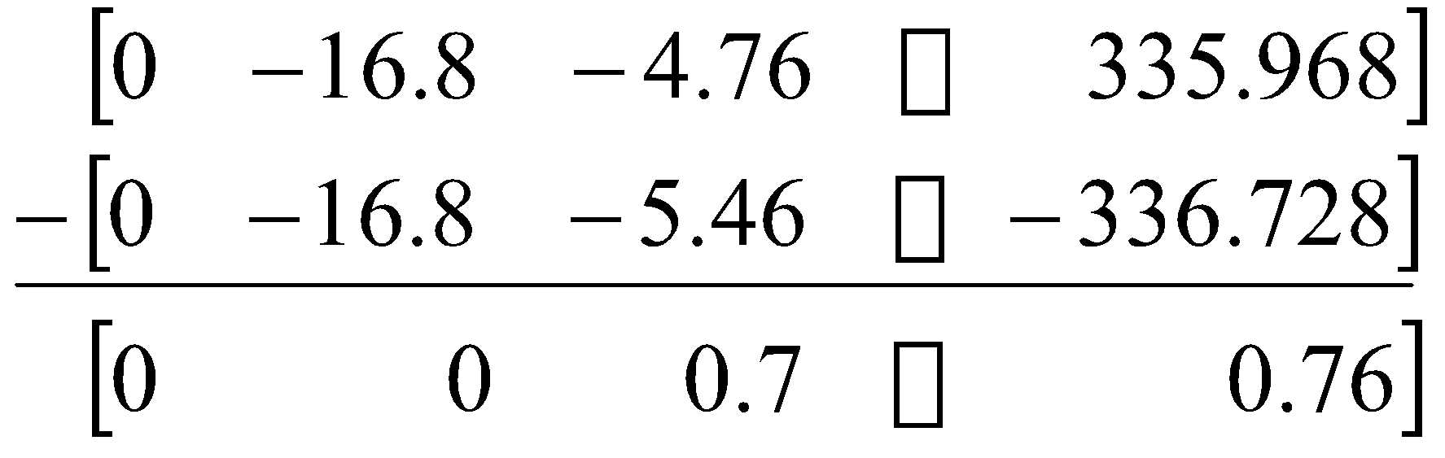
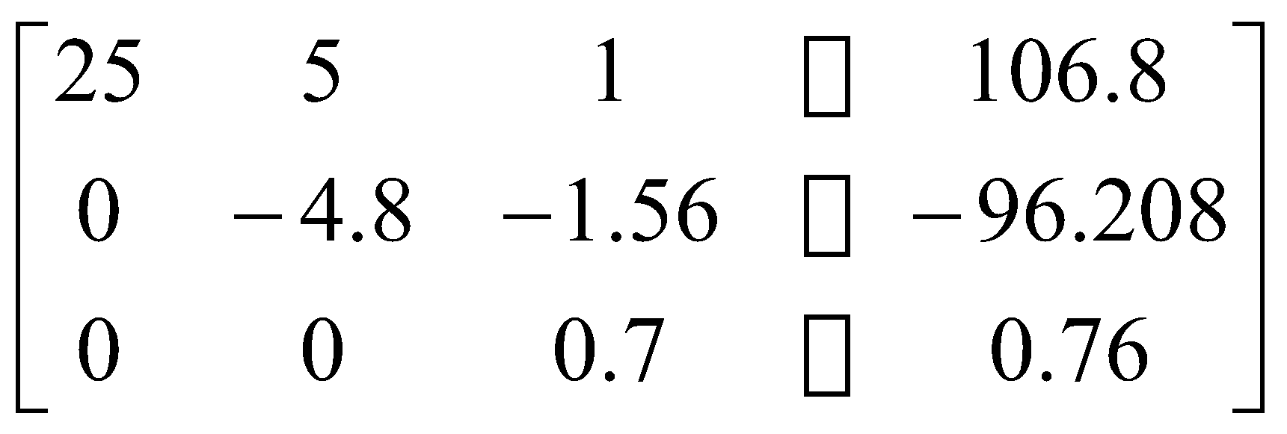
Forward Elimination: Step 2
Divide Equation 2 by −4.8
and multiply it by −16.8,
.
Subtract the result from Equation 3
Substitute new equation for Equation 3
Notes:
‹#›
‹#›

Slide 25
Back Substitution
Notes:
‹#›
‹#›

Slide 26
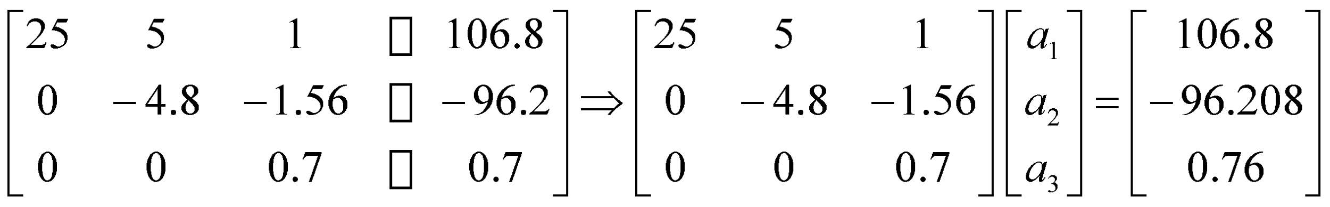
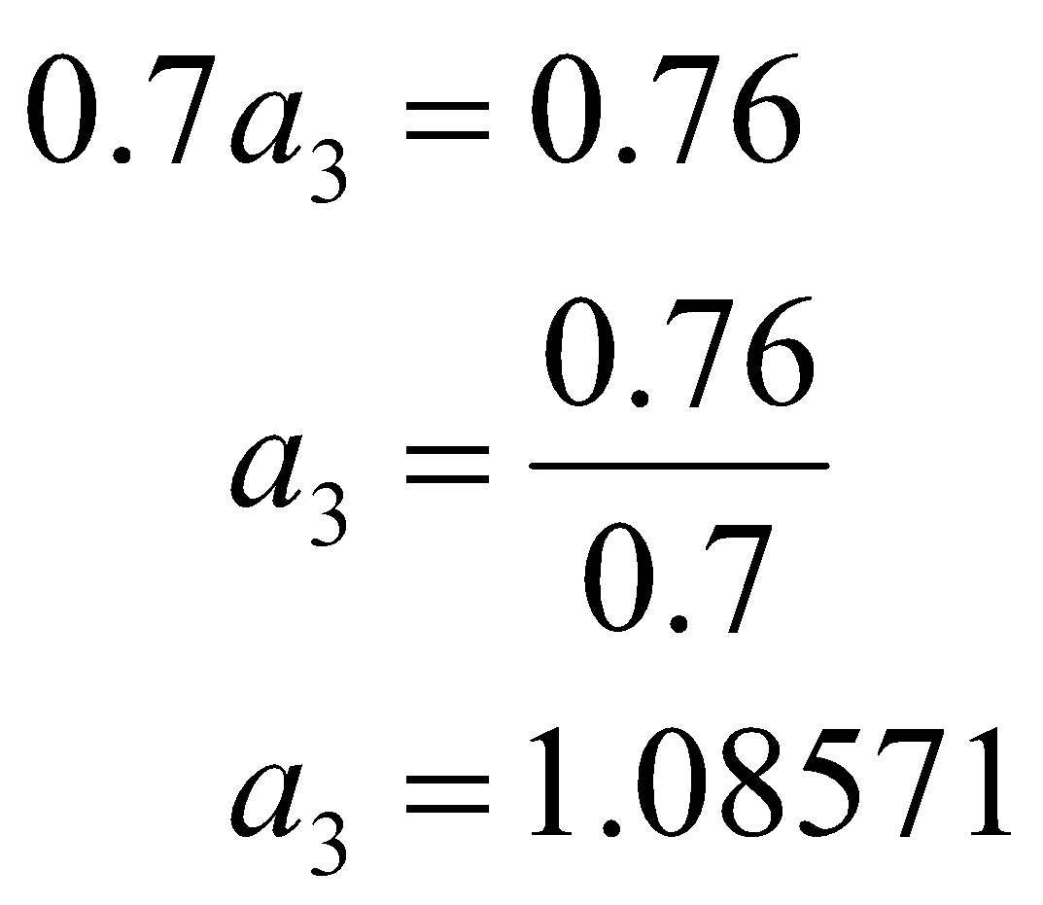
Back Substitution
Solving for a₃
Notes:
‹#›
‹#›

Slide 27
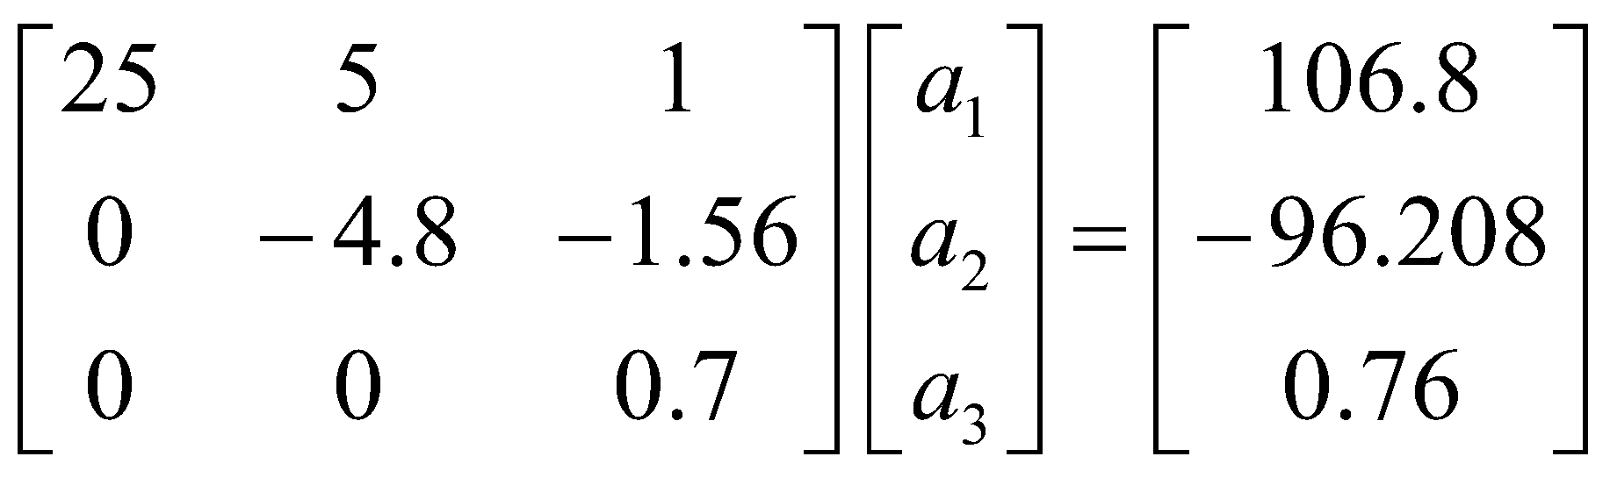
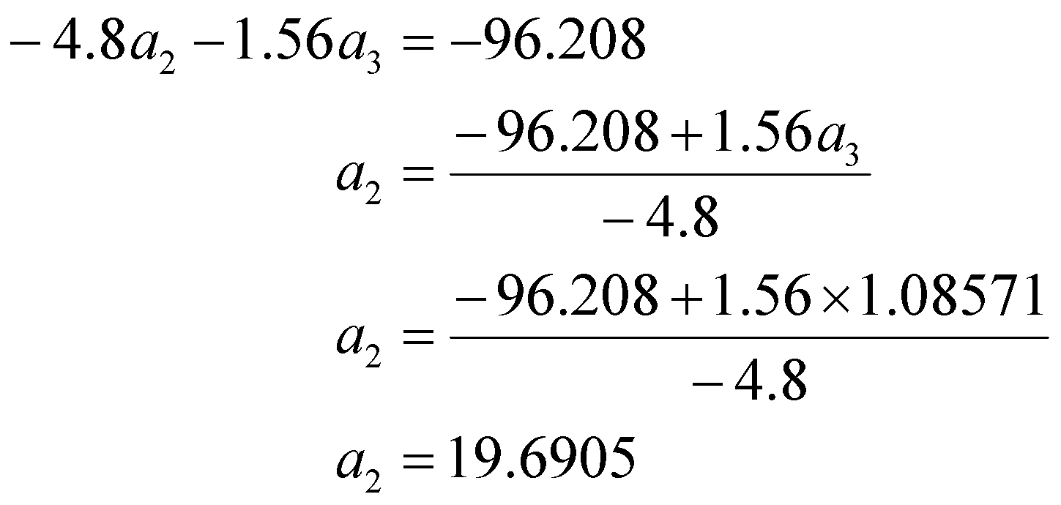
Back Substitution (cont.)
Solving for a₂
Notes:
‹#›
‹#›

Slide 28
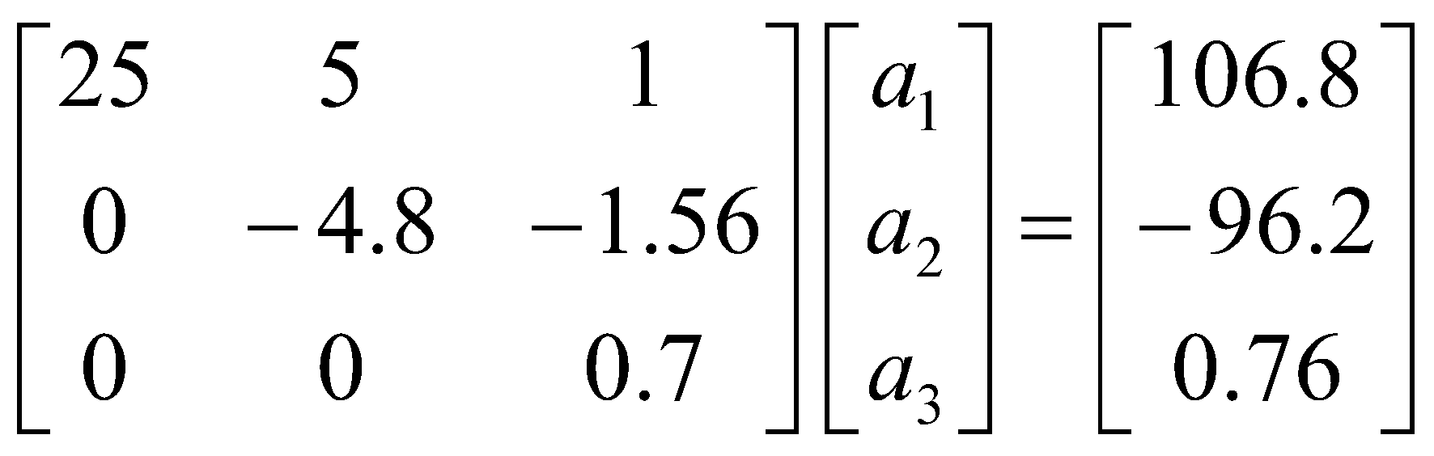
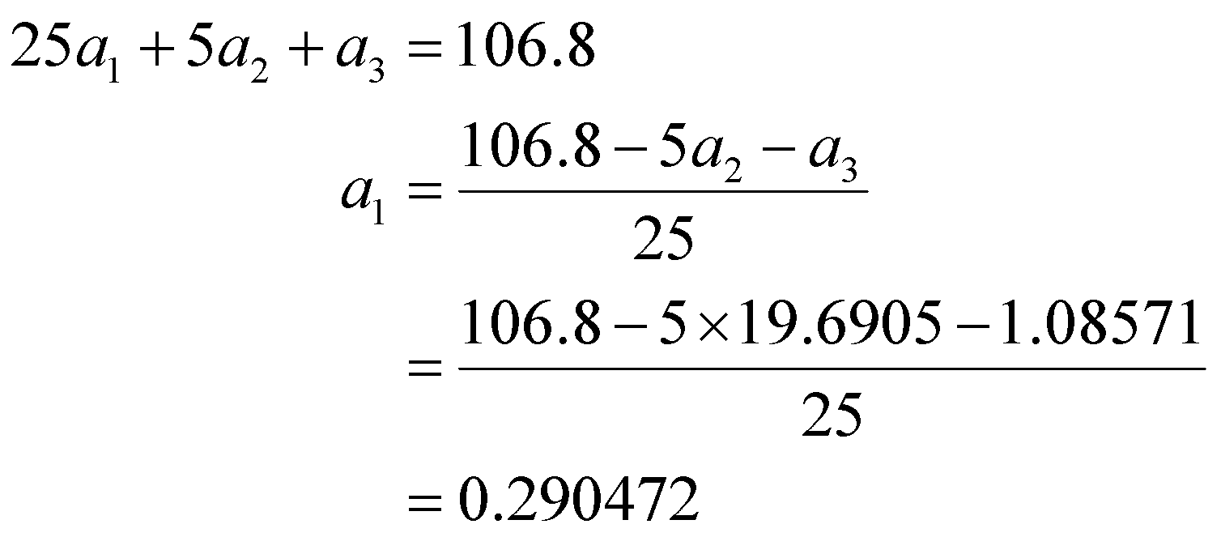

Back Substitution (cont.)
Solving for a₁
Notes:
‹#›
‹#›

Slide 29


Naïve Gaussian Elimination Solution
Notes:
‹#›
‹#›

Slide 30



Example 1 Cont.
Solution
The solution vector is
The polynomial that passes through the three data points is then:
Notes:
‹#›

Slide 31
THE END
Notes:
‹#›

Slide 32
Naïve Gauss Elimination Pitfalls
Notes:
‹#›

Slide 33


Pitfall#1. Division by zero
Notes:
‹#›

Slide 34


Is division by zero an issue here?
Notes:
‹#›

Slide 35



Is division by zero an issue here? YES
Division by zero is a possibility at any step of forward elimination
Notes:
‹#›

Slide 36


Pitfall#2. Large Round-off Errors
Exact Solution
Notes:
‹#›

Slide 37

Pitfall#2. Large Round-off Errors
Solve it on a computer using 6 significant digits with chopping
Notes:
‹#›

Slide 38

Pitfall#2. Large Round-off Errors
Solve it on a computer using 5 significant digits with chopping
Is there a way to reduce the round off error?
Notes:
‹#›

Slide 39
Avoiding Pitfalls
Increase the number of significant digits
Decreases round-off error
Does not avoid division by zero
Notes:
‹#›

Slide 40
Avoiding Pitfalls
Gaussian Elimination with Partial Pivoting
Avoids division by zero
Reduces round off error
Notes:
‹#›

Slide 41
THE END
Notes:
‹#›

Slide 42
Gauss Elimination with Partial Pivoting
Notes:
‹#›

Slide 43
Pitfalls of Naïve Gauss Elimination
Possible division by zero
Large round-off errors
Notes:
‹#›

Slide 44
Avoiding Pitfalls
Increase the number of significant digits
Decreases round-off error
Does not avoid division by zero
Notes:
‹#›

Slide 45
Avoiding Pitfalls
Gaussian Elimination with Partial Pivoting
Avoids division by zero
Reduces round off error
Notes:
‹#›

Slide 46



What is Different About Partial Pivoting?
At the beginning of the k^{th} step of forward elimination, find the maximum of
If the maximum of the values is
in the p ^{th} row,
then switch rows p and k.
Notes:
‹#›

Slide 47

Matrix Form at Beginning of 2nd Step of Forward Elimination
Notes:
‹#›

Slide 48

Example (2nd step of FE)
Which two rows would you switch?
Notes:
‹#›

Slide 49

Example (2nd step of FE)
Switched Rows
Notes:
‹#›

Slide 50
Gaussian Elimination with Partial Pivoting
A method to solve simultaneous linear equations of the form [A][X]=[C]
Two steps
1. Forward Elimination
2. Back Substitution
Notes:
‹#›

Slide 51
Forward Elimination
Same as naïve Gauss elimination method except that we switch rows before each of the (n-1) steps of forward elimination.
Notes:
‹#›

Slide 52
Example: Matrix Form at Beginning of 2nd Step of Forward Elimination
Notes:
‹#›

Slide 53

Matrix Form at End of Forward Elimination
Notes:
‹#›

Slide 54
Back Substitution Starting Eqns
. .
. .
. .
Notes:
‹#›

Slide 55
Back Substitution
Notes:
‹#›

Slide 56
THE END
Notes:
‹#›

Slide 57
Gauss Elimination with Partial Pivoting Example
Notes:
‹#›

Slide 58

Example 2
Solve the following set of equations by Gaussian elimination with partial pivoting
Notes:
‹#›
‹#›

Slide 59


Example 2 Cont.
Forward Elimination
Back Substitution
Notes:
‹#›
‹#›

Slide 60
Forward Elimination
Notes:
‹#›
‹#›

Slide 61
Number of Steps of Forward Elimination
Number of steps of forward elimination is (n−1)=(3−1)=2
Notes:
‹#›

Slide 62


Forward Elimination: Step 1
Examine absolute values of first column, first row
and below.
Largest absolute value is 144 and exists in row 3.
Switch row 1 and row 3.
Notes:
‹#›

Slide 63




Forward Elimination: Step 1 (cont.)
Divide Equation 1 by 144 and
multiply it by 64, .
.
Subtract the result from Equation 2
Substitute new equation for Equation 2
Notes:
‹#›
‹#›

Slide 64




Forward Elimination: Step 1 (cont.)
Divide Equation 1 by 144 and
multiply it by 25, .
.
Subtract the result from Equation 3
Substitute new equation for Equation 3
Notes:
‹#›
‹#›

Slide 65


Forward Elimination: Step 2
Examine absolute values of second column, second row
and below.
Largest absolute value is 2.917 and exists in row 3.
Switch row 2 and row 3.
Notes:
‹#›

Slide 66




Forward Elimination: Step 2 (cont.)
Divide Equation 2 by 2.917 and
multiply it by 2.667,
.
Subtract the result from Equation 3
Substitute new equation for Equation 3
Notes:
‹#›
‹#›

Slide 67
Back Substitution
Notes:
‹#›
‹#›

Slide 68


Back Substitution
Solving for a₃
Notes:
‹#›
‹#›

Slide 69


Back Substitution (cont.)
Solving for a₂
Notes:
‹#›
‹#›

Slide 70

Back Substitution (cont.)
Solving for a₁
Notes:
‹#›
‹#›

Slide 71


Gaussian Elimination with Partial Pivoting Solution
Notes:
‹#›
‹#›

Slide 72
Gauss Elimination with Partial Pivoting Another Example
Notes:
‹#›

Slide 73




Partial Pivoting: Example
Consider the system of equations
In matrix form
=
Solve using Gaussian Elimination with Partial Pivoting using five significant digits with chopping
Notes:
‹#›

Slide 74



Partial Pivoting: Example
Forward Elimination: Step 1
Examining the values of the first column
|10|, |-3|, and |5| or 10, 3, and 5
The largest absolute value is 10, which means, to follow the rules of Partial Pivoting, we switch row1 with row1.
Performing Forward Elimination
Notes:
‹#›

Slide 75

Partial Pivoting: Example
Forward Elimination: Step 2
Examining the values of the first column
|-0.001| and |2.5| or 0.0001 and 2.5
The largest absolute value is 2.5, so row 2 is switched with row 3
Performing the row swap
Notes:
‹#›

Slide 76

Partial Pivoting: Example
Forward Elimination: Step 2
Performing the Forward Elimination results in:
Notes:
‹#›

Slide 77




Partial Pivoting: Example
Back Substitution
Solving the equations through back substitution
Notes:
‹#›

Slide 78


Partial Pivoting: Example
Compare the calculated and exact solution
The fact that they are equal is coincidence, but it does illustrate the advantage of Partial Pivoting
Notes:
‹#›

Slide 79
THE END
Notes:
‹#›

Slide 80
Determinant of a Square Matrix Using Naïve Gauss Elimination Example
Notes:
‹#›
‹#›

Slide 81
Theorem of Determinants
If a multiple of one row of [A]_{nxn} is added or subtracted to another row of [A]_{nxn} to result in [B]_{nxn} then det(A)=det(B)
Notes:
‹#›
‹#›

Slide 82

Theorem of Determinants
The determinant of an upper triangular matrix [A]_{nxn} is given by
Notes:
‹#›
‹#›

Slide 83


Forward Elimination of a Square Matrix
Using forward elimination to transform [A]_{nxn} to an upper triangular matrix, [U]_{nxn}.
Notes:
‹#›
‹#›

Slide 84

Example
Using naïve Gaussian elimination find the determinant of the following square matrix.
Notes:
‹#›
‹#›

Slide 85
Forward Elimination
Notes:
‹#›
‹#›

Slide 86



Forward Elimination: Step 1
Divide Equation 1 by 25 and
multiply it by 64, .
.
Subtract the result from Equation 2
Substitute new equation for Equation 2
Notes:
‹#›
‹#›

Slide 87



Forward Elimination: Step 1 (cont.)
Divide Equation 1 by 25 and
multiply it by 144, .
.
Subtract the result from Equation 3
Substitute new equation for Equation 3
Notes:
‹#›
‹#›

Slide 88



Forward Elimination: Step 2
Divide Equation 2 by −4.8
and multiply it by −16.8,
.
.
Subtract the result from Equation 3
Substitute new equation for Equation 3
Notes:
‹#›
‹#›

Slide 89


Finding the Determinant
After forward elimination
.
Notes:
‹#›
‹#›

Slide 90
Summary
Forward Elimination
Back Substitution
Pitfalls
Improvements
Partial Pivoting
Determinant of a Matrix
Notes:
‹#›

Slide 91
THE END
Notes:
‹#›

